Slide 1
W4111 – Introduction to Databases Section 002, Spring 2023 Lecture 3: ER, Relational, SQL (II)
© Donald F. Ferguson, 2023

Slide 2

Contents
2 | COMS W4111_002_2023_1: Lecture 3: ER, Relational, SQL (II) © Donald F. Ferguson, 2023

Slide 3
Contents
Some information and references to help with HW 1
Data modeling:
Crow’s Foot Notation
Worked Crow’s Foot modeling → DDL
Introduction to Pandas, including CSV and SQL.
More advanced relational algebra and the dreaded “RelaX Calculator.”
Diving deeper into SQL.
Discuss HW notebook and project code.

Slide 4
Some More Relational Algebra
4 | COMS W4111_002_2023_1: Lecture 3: ER, Relational, SQL (II) © Donald F. Ferguson, 2023

Slide 5
Relational Algebra
A procedural language consisting of a set of operations that take one or two relations as input and produce a new relation as their result.
Six basic operators
select: σ
project: ∏
union: ∪
set difference: –
Cartesian product: x
rename: ρ

Slide 6
Union Operation
The union operation allows us to combine two relations
Notation: r ∪ s
For r ∪ s to be valid.
1. r, s must have the same arity (same number of attributes)
2. The attribute domains must be compatible (example: 2nd
column of r deals with the same type of values as does the 2nd column of s)
Example: to find all courses taught in the Fall 2017 semester, or in the Spring 2018 semester, or in both ∏_{course_id} (σ _{semester=“Fall” Λ year=2017} (section)) ∪ ∏_{course_id} (σ _{semester=“Spring” Λ year=2018} (section))

Slide 7
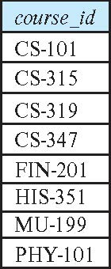
Union Operation (Cont.)
Result of: ∏_{course_id} (σ _{semester=“Fall” Λ year=2017} (section)) ∪ ∏_{course_id} (σ _{semester=“Spring” Λ year=2018} (section))
Note: The preloaded dataset on the RelaX calculator is different from the most recent data referenced in the book. It is from a previous edition.

Slide 8
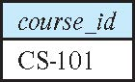
Set-Intersection Operation
The set-intersection operation allows us to find tuples that are in both the input relations.
Notation: r ∩ s
Assume:
r, s have the same arity
attributes of r and s are compatible
Example: Find the set of all courses taught in both the Fall 2017 and the Spring 2018 semesters.
∏_{course_id} (σ _{semester=“Fall” Λ year=2017} (section)) ∩ ∏_{course_id} (σ _{semester=“Spring” Λ year=2018} (section))
Result

Slide 9
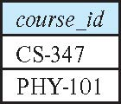
Set Difference Operation
The set-difference operation allows us to find tuples that are in one relation but are not in another.
Notation r – s
Set differences must be taken between compatible relations.
r and s must have the same arity
attribute domains of r and s must be compatible
Example: to find all courses taught in the Fall 2017 semester, but not in the Spring 2018 semester ∏_{course_id} (σ _{semester=“Fall” Λ year=2017} (section)) − ∏_{course_id} (σ _{semester=“Spring” Λ year=2018} (section))

Slide 10
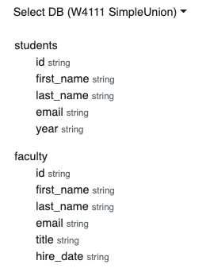
Same “arity”
Same “arity”
Same number of columns.
Compatible types.
The i-th column in each table is from a compatible domain.
Student 5th column is “year.”
Faculty 5th column is “title”
Both are strings but combing them does not make sense.
You can shape two incompatible tables using project operations. For example
π first_name,last_name,email (students) ∩ π first_name,last_name,email (faculty)
π last_name,email, title←'Student' (students) ∪ π last_name,email, title (faculty)

Slide 11
The Assignment Operation
It is convenient at times to write a relational-algebra expression by assigning parts of it to temporary relation variables.
The assignment operation is denoted by ← and works like assignment in a programming language.
Example: Find all instructor in the “Physics” and Music department. Physics ← σ _{dept_name=“Physics”} (instructor)
Music ← σ _{dept_name=“Music”} (instructor)
Physics ∪ Music
With the assignment operation, a query can be written as a sequential program consisting of a series of assignments followed by an expression whose value is displayed as the result of the query.
The RelaX Calculator handles ← differently.

Slide 12
The Rename Operation
The results of relational-algebra expressions do not have a name that we can use to refer to them. The rename operator, ρ , is provided for that purpose
The expression:
ρ_{x} (E)
returns the result of expression E under the name x
Another form of the rename operation:
ρ_{x(A1,A2, .. An)} (E)
Note: Assignment and rename can act a little wonky when using the calculator.

Slide 13
Equivalent Queries
There is more than one way to write a query in relational algebra.
Example: Find information about courses taught by instructors in the Physics department with salary greater than 90,000
Query 1
σ _{dept_name=“Physics”} ∧ _{salary > 90,000} (instructor)
Query 2
σ _{dept_name=“Physics”} (σ _{salary > 90.000} (instructor))
The two queries are not identical; they are, however, equivalent -- they give the same result on any database.

Slide 14
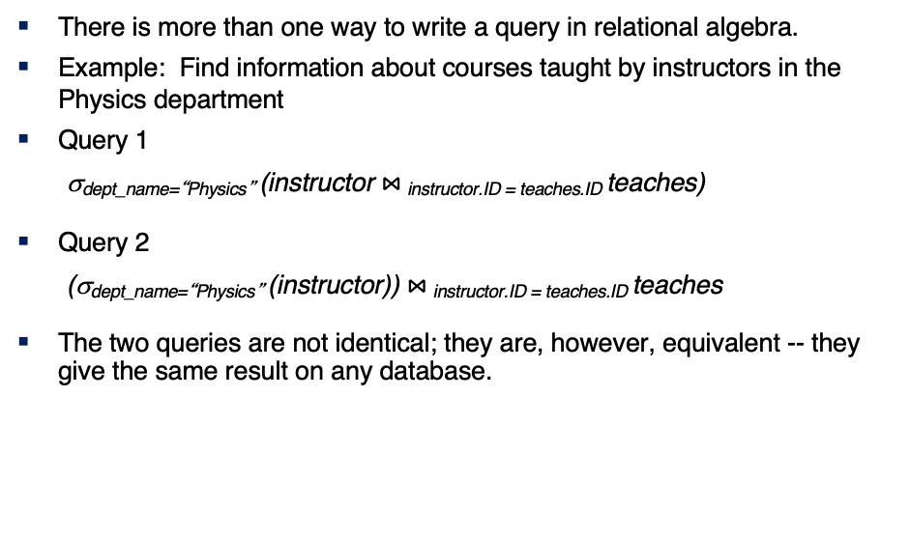
Equivalent Queries
There is more than one way to write a query in relational algebra.
Example: Find information about courses taught by instructors in the Physics department
Query 1
σ_{dept_name=“Physics”} (instructor $⋈_{ }$_{instructor.ID = teaches.ID} teaches)
Query 2
(σ_{dept_name=“Physics”} (instructor)) $⋈_{ }$_{instructor.ID = teaches.ID} teaches
The two queries are not identical; they are, however, equivalent -- they give the same result on any database.

Slide 15
What are all those other Symbols?
Some of the operators are useful and “common,” but not always considered part of the core algebra.
Some of these are pretty obscure
Division
Anti-Join
Left semi-join
Right semi-join
Most SQL engines do not support them.
You can implement them using combinations of JOIN, SELECT, WHERE, ... ...
But, I cannot every remember using them in applications I have developed.
Outer JOIN is very useful, but less common. We will cover.
There are also some “patterns” or “terms”
Equijoin
Non-equi join
Natural join
Theta join
... ...
I may ask you to define these terms on some exams or the obscure operatorsbecause they may be common internships/job interview questions.
τ order by
γ group by
¬ negation
÷ set division
⨝ natural join, theta-join
⟕ left outer join
⟖ right outer join
⟗ full outer join
⋉ left semi join
⋊ right semi join
▷ anti-join

Slide 16
Thinking about JOINs
Some terms:
Natural Join
Equality of A and B columns
With the same name.
Equijoin
Explicitly specify columns that must have the same value.
A.x=B.z AND A.q=B.w
Theta Join: Arbitrary predicate.
Inner Join
JOIN “matches” rows in A and B.
Result contains ONLY the matched pairs.
What is I want:
All the rows that matched.
And the rows from A that did not match?
OUTER JOIN (⟖, ⟕)

Slide 17
Some Examples
A course and its prerequisites
π course_id←course.course_id,
course_title←course.title,
prerequisite_id←prereq.prereq_id,
prerequisite_title←p.course_id
(
(course ⨝ prereq)
⨝ prereq.prereq_id=p.course_id
ρ p(course))
Join course and prereq to get
course info
prereq_id
Join with
course using prereq_id
To get the prereq info
But,
course.course_id is ambiguous
Because the table appears twice.
So, I have to “alias” the second use.
Also, note the use of renaming in the project for column names.

Slide 18
Some Examples
Courses-prerequisites and courses without prereqs.
τ prerequisite_id
(π course_id←course.course_id,
course_title←course.title,
prerequisite_id←prereq.prereq_id,
prerequisite_title←p.course_id
(
(course ⟕ prereq)
⟕ prereq.prereq_id=p.course_id
ρ p(course))
)

Slide 19
Some Examples
Courses that are not prerequisites
τ prereq_course_id
(
π prereq_course_id←prereq.course_id,
course_id←course.course_id,
course_title←course.title
(
prereq ⟖ prereq_id=course.course_id course
)
)

Slide 20
Relational Algebra
We will do more examples in lectures, HW assignments and exams.
The language is interesting but can be tedious and confusing.
Useful in some advanced scenarios:
Designing query languages for new databases and data models.
Understanding how DBMS implement query processing and optimization.
Also cover because it does come up in some advanced courses, and may come up in job interviews.
I give take home exams and homework assignments:
I cannot remember some of the more obscure operators.
You have to tinker with the expressions to get an answer.

Slide 21
Some More SQL
21 | COMS W4111_002_2023_1: Lecture 3: ER, Relational, SQL (II) © Donald F. Ferguson, 2023

Slide 22

Data Types and Functions
22 | COMS W4111_002_2023_1: Lecture 3: ER, Relational, SQL (II) © Donald F. Ferguson, 2023

Slide 23
Domain Types in SQL
char(n). Fixed length character string, with user-specified length n.
varchar(n). Variable length character strings, with user-specified maximum length n.
int. Integer (a finite subset of the integers that is machine-dependent).
smallint. Small integer (a machine-dependent subset of the integer domain type).
numeric(p,d). Fixed point number, with user-specified precision of p digits, with d digits to the right of decimal point. (ex., numeric(3,1), allows 44.5 to be stores exactly, but not 444.5 or 0.32)
real, double precision. Floating point and double-precision floating point numbers, with machine-dependent precision.
float(n). Floating point number, with user-specified precision of at least n digits.
More are covered in Chapter 4.

Slide 24
Built-in Data Types in SQL
date: Dates, containing a (4 digit) year, month and date
Example: date '2005-7-27'
time: Time of day, in hours, minutes and seconds.
Example: time '09:00:30' time '09:00:30.75'
timestamp: date plus time of day
Example: timestamp '2005-7-27 09:00:30.75'
interval: period of time
Example: interval '1' day
Subtracting a date/time/timestamp value from another gives an interval value
Interval values can be added to date/time/timestamp values
Note:
All implementations of SQL support a common core, but ...
The have proprietary extensions: operators on types, additional types.

Slide 25
Large-Object Types
Large objects (photos, videos, CAD files, etc.) are stored as a large object:
blob: binary large object -- object is a large collection of uninterpreted binary data (whose interpretation is left to an application outside of the database system)
clob: character large object -- object is a large collection of character data
When a query returns a large object, a pointer is returned rather than the large object itself.
MySQL:
TEXT CLOB VARCHAR(64000)
Note:
CLOBs and BLOBs are very uncommon.
Today applications keep documents, images, CAD files, etc. in “block/object storage.”
The database contains just the hyperlinks to the files/content.
We will see some examples when we talk about web applications.

Slide 26
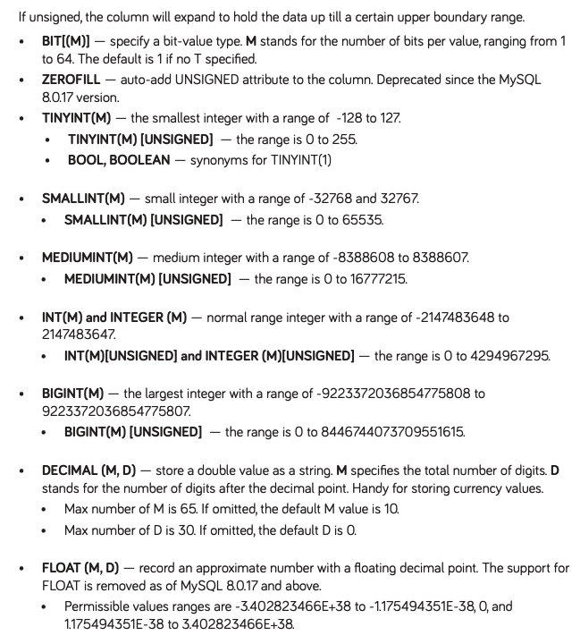
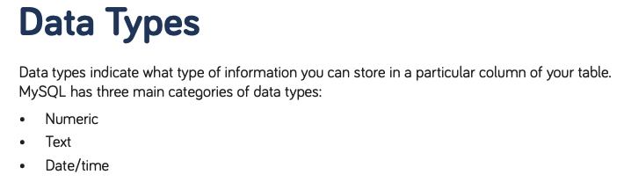
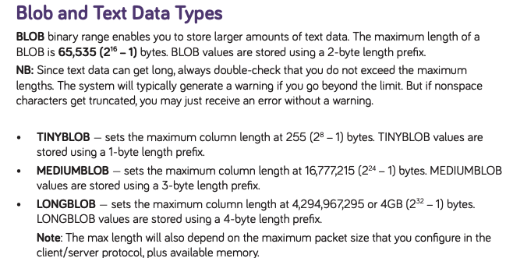
MySQL Cheat Sheet
https://websitesetup.org/wp-content/uploads/2020/04/MySQL-Cheat-Sheet-websitesetup.org.pdf Pretty good, concise place to find information about MySQL.
https://dev.mysql.com/doc/refman/8.0/en/data-types.html
These lists are not complete.

Slide 27
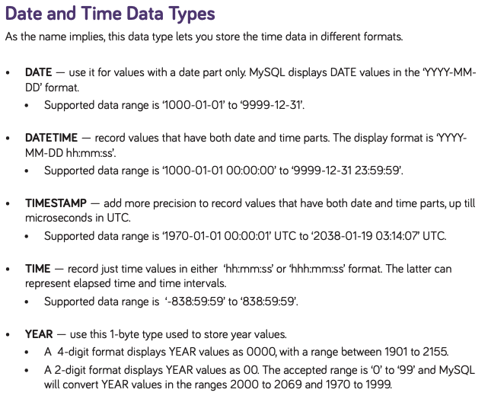
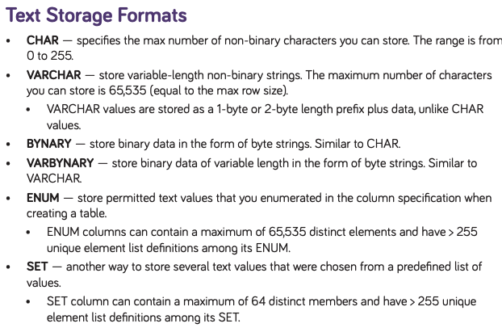
MySQL Cheat Sheet
https://websitesetup.org/wp-content/uploads/2020/04/MySQL-Cheat-Sheet-websitesetup.org.pdf Pretty good, concise place to find information about MySQL.
https://dev.mysql.com/doc/refman/8.0/en/data-types.html
These lists are not complete for the basic groups, and there are some advanced types (JSON, Spatial).
You learn all of this by practicing, trial and error, etc.

Slide 28
String Operations
SQL includes a string-matching operator for comparisons on character strings. The operator like uses patterns that are described using two special characters:
percent ( % ). The % character matches any substring.
underscore ( _ ). The _ character matches any character.
Find the names of all instructors whose name includes the substring “dar”.
select name from instructor where name like '%dar%'
Match the string “100%”
like '100 \%' escape '\'
in that above we use backslash (\) as the escape character.

Slide 29
String Operations (Cont.)
Patterns are case sensitive.
Pattern matching examples:
'Intro%' matches any string beginning with “Intro”.
'%Comp%' matches any string containing “Comp” as a substring.
'_ _ _' matches any string of exactly three characters.
'_ _ _ %' matches any string of at least three characters.
SQL supports a variety of string operations such as
concatenation (using “||”)
converting from upper to lower case (and vice versa)
finding string length, extracting substrings, etc.

Slide 30
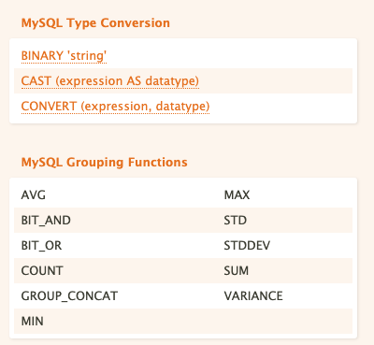
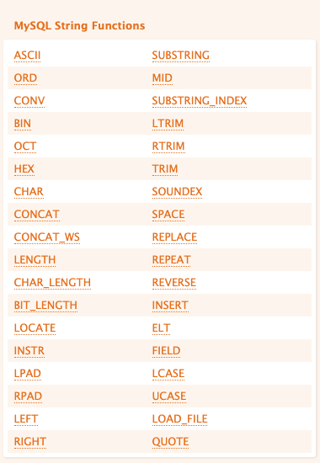
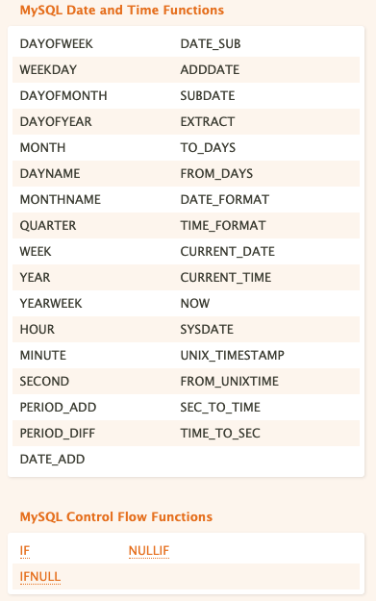
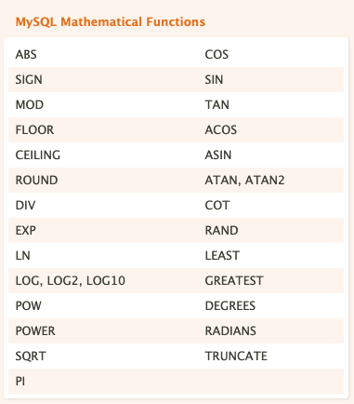
Operations and Functions
Almost all programming languages have similar function libraries.

Slide 31
Operations and Functions
How do you learn all of these functions?
Well, “How do I get to Carnegie Hall?”
“Practice.”

Slide 32
Summary
SQL Data Types:
There is a common, standard core set of data types that all SQL implementations support.
Most SQL implementations have additional types and extensions.
Functions on Data Types:
There is a common, standard core set of functions for each data type that all SQL implementations support.
Most SQL implementations have additional functions and extensions.
I do not expect you to memorize the types, functions, etc. You can look them up, play with them, ... On homework assignments and exams.
We saw some interesting additional features that we will cover later in this lecture:
GROUP BY
ORDER BY

Slide 33
Order By
33 | COMS W4111_002_2023_1: Lecture 3: ER, Relational, SQL (II) © Donald F. Ferguson, 2023

Slide 34
Ordering the Display of Tuples
List in alphabetic order the names of all instructors
select distinct name from instructor order by name
We may specify desc for descending order or asc for ascending order, for each attribute; ascending order is the default.
Example: order by name desc
Can sort on multiple attributes
Example: order by dept_name, name

Slide 35
INSERT, UPDATE, DELETE
35 | COMS W4111_002_2023_1: Lecture 3: ER, Relational, SQL (III) © Donald F. Ferguson, 2023

Slide 36
Updates to tables
Insert
insert into instructor values ('10211', 'Smith', 'Biology', 66000);
Delete
Remove all tuples from the student relation
delete from student
Drop Table
drop table r
Alter
alter table r add A D
where A is the name of the attribute to be added to relation r and D is the domain of A.
All exiting tuples in the relation are assigned null as the value for the new attribute.
alter table r drop A
where A is the name of an attribute of relation r
Dropping of attributes not supported by many databases.

Slide 37
Modification of the Database
Deletion of tuples from a given relation.
Insertion of new tuples into a given relation
Updating of values in some tuples in a given relation

Slide 38
Deletion
Delete all instructors
delete from instructor
Delete all instructors from the Finance department delete from instructor where dept_name= 'Finance’;
Delete all tuples in the instructor relation for those instructors associated with a department located in the Watson building.
delete from instructor where dept name in (select dept name from department where building = 'Watson');

Slide 39
Deletion (Cont.)
Delete all instructors whose salary is less than the average salary of instructors
Problem: as we delete tuples from instructor, the average salary changes
Solution used in SQL:
First, compute avg (salary) and find all tuples to delete
Next, delete all tuples found above (without recomputing avg or retesting the tuples)
delete from instructor
where salary < (select avg (salary)
from instructor);

Slide 40
Insertion
Add a new tuple to course
insert into course values ('CS-437', 'Database Systems', 'Comp. Sci.', 4);
or equivalently
insert into course (course_id, title, dept_name, credits) values ('CS-437', 'Database Systems', 'Comp. Sci.', 4);
Add a new tuple to student with tot_creds set to null
insert into student values ('3003', 'Green', 'Finance', null);

Slide 41
Insertion (Cont.)
Make each student in the Music department who has earned more than 144 credit hours an instructor in the Music department with a salary of $18,000.
insert into instructor select ID, name, dept_name, 18000 from student where dept_name = 'Music' and total_cred > 144;
The select from where statement is evaluated fully before any of its results are inserted into the relation.
Otherwise queries like
insert into table1 select * from table1
would cause problem

Slide 42
Updates
Give a 5% salary raise to all instructors
update instructor set salary = salary * 1.05
Give a 5% salary raise to those instructors who earn less than 70000 update instructor set salary = salary * 1.05 where salary < 70000;
Give a 5% salary raise to instructors whose salary is less than average
update instructor set salary = salary * 1.05 where salary < (select avg (salary) from instructor);

Slide 43
Updates (Cont.)
Increase salaries of instructors whose salary is over $100,000 by 3%, and all others by a 5%
Write two update statements:
update instructor set salary = salary * 1.03 where salary > 100000; update instructor set salary = salary * 1.05 where salary <= 100000;
The order is important
Can be done better using the case statement (next slide)

Slide 44
Case Statement for Conditional Updates
Same query as before but with case statement
update instructor set salary = case when salary <= 100000 then salary * 1.05 else salary * 1.03 end

Slide 45
Updates with Scalar Subqueries
Recompute and update tot_creds value for all students
update student S set tot_cred = (select sum(credits) from takes, course where takes.course_id = course.course_id and S.ID= takes.ID.and takes.grade <> 'F' and takes.grade is not null);
Sets tot_creds to null for students who have not taken any course
Instead of sum(credits), use:
case when sum(credits) is not null then sum(credits) else 0 end

Slide 46
Summary
INSERT, UPDATE and DELETE are pretty straightforward.
UPDATE and DELETE are very similar to SELECT
WHERE clause specifies which rows are affected.
The SELECT choose the columns to return.
The SET clause chooses and changes columns.
DELETE just removes the specified rows.
INSERT, UPDATE and DELETE changes must not violate constraints, e.g.
INSERT a row that causes a duplicate key.
DELETE a referenced (target) foreign key.
UPDATE columns that create a duplicate key.
INSERT values do not include all NOT NULL columns.
I am not going to do example now, but you have seen and will see me do examples in the context of larger examples.

Slide 47
Aggregate Functions
47 | COMS W4111_002_2023_1: Lecture 3: ER, Relational, SQL (III) © Donald F. Ferguson, 2023

Slide 48
Aggregate Functions
These functions operate on the multiset of values of a column of a relation, and return a value
avg: average value min: minimum value max: maximum value sum: sum of values count: number of values
Note: Some database implementations have additional aggregate functions.

Slide 49
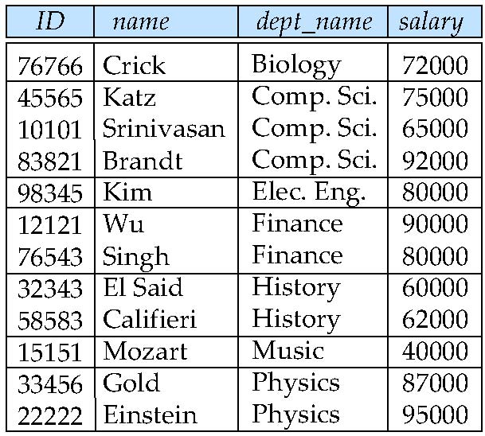
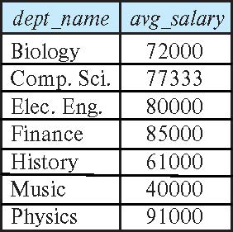
Aggregate Functions – Group By
Find the average salary of instructors in each department
select dept_name, avg (salary) as avg_salary from instructor group by dept_name;

Slide 50
Another View
GROUP BY column list
Forms partitions containing multiple rows.
All rows in a partition have the same values for the GROUP BY columns.
The aggregate functions
Merge the non-group by attributes, which may differ from row to row.
Into a single value for each attribute.
The result is one row per distinct set of GROUP BY values.
There may be multiple non-GROUP BY COLUMNS, each with its own aggregate function.
You can use HAVING in place of WHERE on the GROUP BY result.

Slide 51
Aggregate Functions Examples
Find the average salary of instructors in the Computer Science department
select avg (salary) from instructor where dept_name= 'Comp. Sci.';
Find the total number of instructors who teach a course in the Spring 2018 semester
select count (distinct ID) from teaches where semester = 'Spring' and year = 2018;
Find the number of tuples in the course relation
select count (*) from course;

Slide 52
Aggregation (Cont.)
Attributes in select clause outside of aggregate functions must appear in group by list
/* erroneous query */ select dept_name, ID, avg (salary) from instructor group by dept_name;

Slide 53
Aggregate Functions – Having Clause
Find the names and average salaries of all departments whose average salary is greater than 42000
Note: predicates in the having clause are applied after the formation of groups whereas predicates in the where clause are applied before forming groups
select dept_name, avg (salary) as avg_salary
from instructor
group by dept_name
having avg (salary) > 42000;

Slide 54
JOIN
54 | COMS W4111_002_2023_1: Lecture 3: ER, Relational, SQL (III) © Donald F. Ferguson, 2023

Slide 55
Joined Relations
Join operations take two relations and return as a result another relation.
A join operation is a Cartesian product which requires that tuples in the two relations match (under some condition). It also specifies the attributes that are present in the result of the join
The join operations are typically used as subquery expressions in the from clause
Three types of joins:
Natural join
Inner join
Outer join
Notes:
You will also hear terms like equi-join, non-equi-join, theta join, semi-join, ... ...
I ask for definitions on exams, but you can just look them up.

Slide 56
Natural Join in SQL
Natural join matches tuples with the same values for all common attributes, and retains only one copy of each common column.
List the names of instructors along with the course ID of the courses that they taught
select name, course_id from students, takes where student.ID = takes.ID;
Same query in SQL with “natural join” construct
select name, course_id from student natural join takes;

Slide 57
Natural Join in SQL (Cont.)
The from clause can have multiple relations combined using natural join:
select A₁, A₂, … A_{n} from r₁ natural join r₂ natural join .. natural join r_{n} where P ;

Slide 58
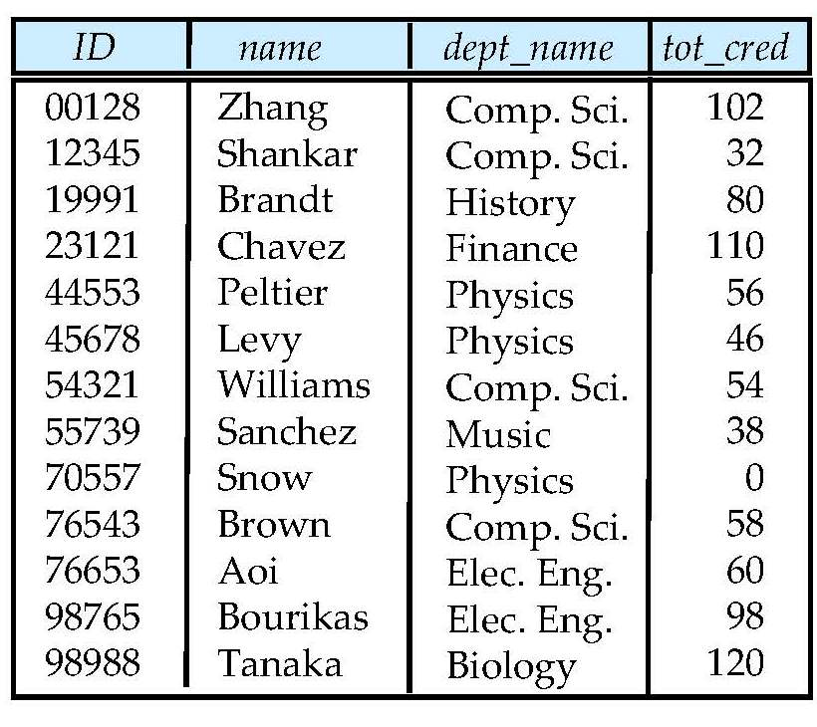
Student Relation

Slide 59
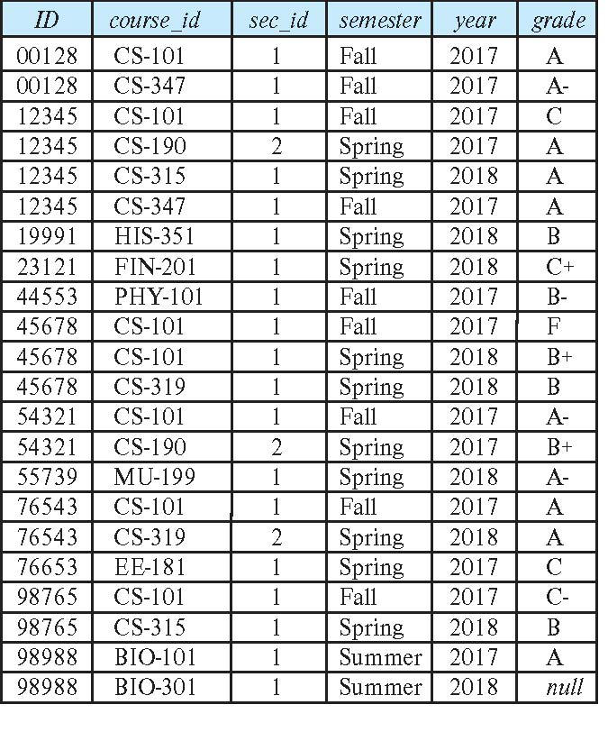
Takes Relation

Slide 60
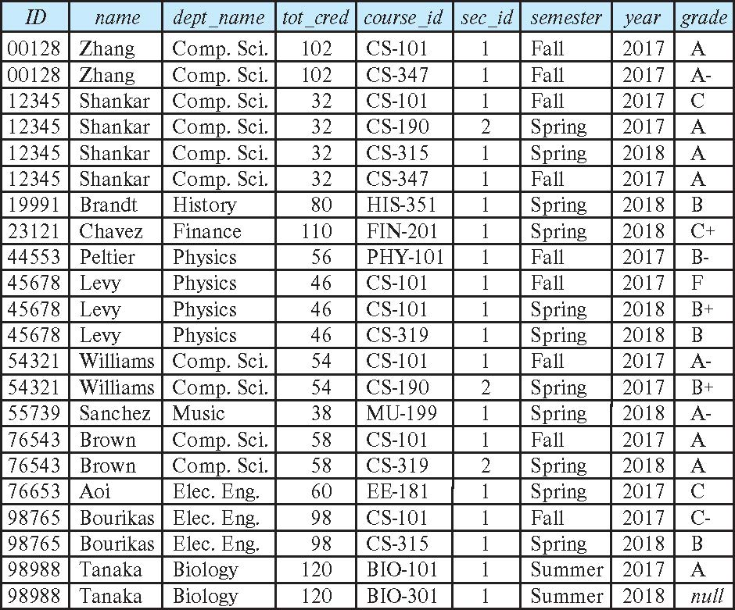
student natural join takes

Slide 61
Dangerous in Natural Join
Beware of unrelated attributes with same name which get equated incorrectly
Example -- List the names of students instructors along with the titles of courses that they have taken
Correct version
select name, title from student natural join takes, course where takes.course_id = course.course_id;
Incorrect version
select name, title from student natural join takes natural join course;
This query omits all (student name, course title) pairs where the student takes a course in a department other than the student's own department.
The correct version (above), correctly outputs such pairs.

Slide 62
Natural Join with Using Clause
To avoid the danger of equating attributes erroneously, we can use the “using” construct that allows us to specify exactly which columns should be equated.
Query example
select name, title from (student natural join takes) join course using (course_id)

Slide 63
Join Condition
The on condition allows a general predicate over the relations being joined
This predicate is written like a where clause predicate except for the use of the keyword on
Query example
select * from student join takes on student_ID = takes_ID
The on condition above specifies that a tuple from student matches a tuple from takes if their ID values are equal.
Equivalent to:
select * from student , takes where student_ID = takes_ID

Slide 64
Join Condition (Cont.)
The on condition allows a general predicate over the relations being joined.
This predicate is written like a where clause predicate except for the use of the keyword on.
Query example
select * from student join takes on student_ID = takes_ID
The on condition above specifies that a tuple from student matches a tuple from takes if their ID values are equal.
Equivalent to:
select * from student , takes where student_ID = takes_ID

Slide 65
One Way to Think About Joins

Slide 66
HW 1 – Help Cover Some Topics
66 | COMS W4111_002_2023_1: Lecture 3: ER, Relational, SQL (II) © Donald F. Ferguson, 2023

Slide 67
ER Modeling: Review, Worked Example
67 | COMS W4111_002_2023_1: Lecture 3: ER, Relational, SQL (II) © Donald F. Ferguson, 2023

Slide 68
Crow’s Foot Notation – Relationships
There are several aspects to entity-entity relationships. The core concepts are:
Cardinality: binary, 3 entities, 4, entities, ... ...
Multiplicity
Mandatory/Optional (also known as partial participation, total participation)
There is a great on-line tutorial if you need to refresh your memory and get additional information. https://www.vertabelo.com/blog/crow-s-foot-notation/
There are several other notations.
The book uses more formal ER Model (https://en.wikipedia.org/wiki/Entity%E2%80%93relationship_model).
I find this tedious and to be overkill, but we will see that it is more complete.

Slide 69
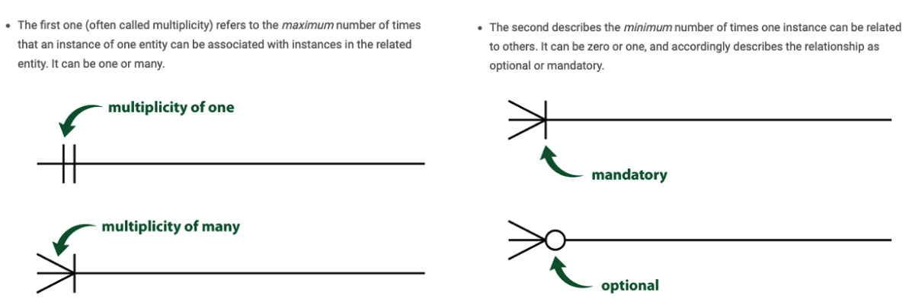
Crow’s Foot Notation – Relationships

Slide 70
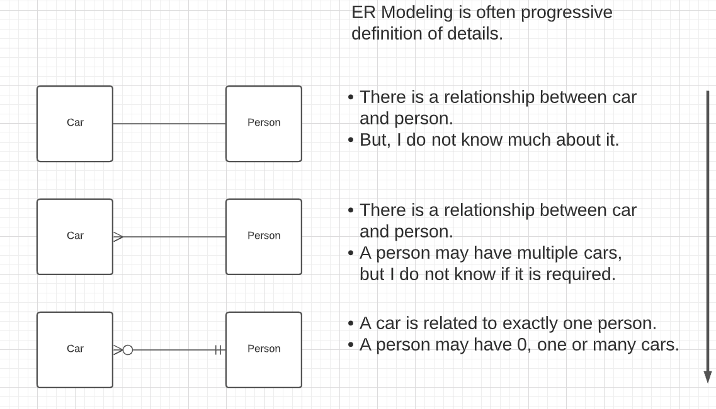
Crow’s Foot Notation – Relationships
What about those other endings in Lucidchart?

Slide 71

Worked Example
Scenario
Course with complex course ID.
Section
Instructor
Department
School
Do ER (live) diagram in Lucidchart.
Do schema creation
In DataGrip
Show copying statements int the notebook.
No laughing when I make
mistakes!

Slide 72
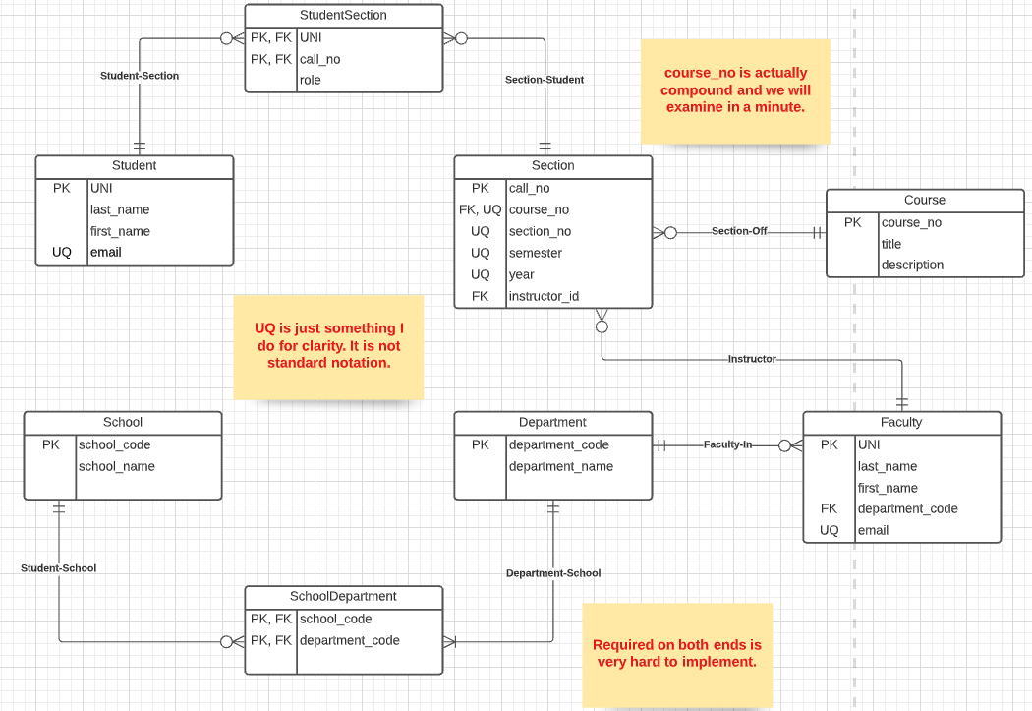
Final Draft

Slide 73
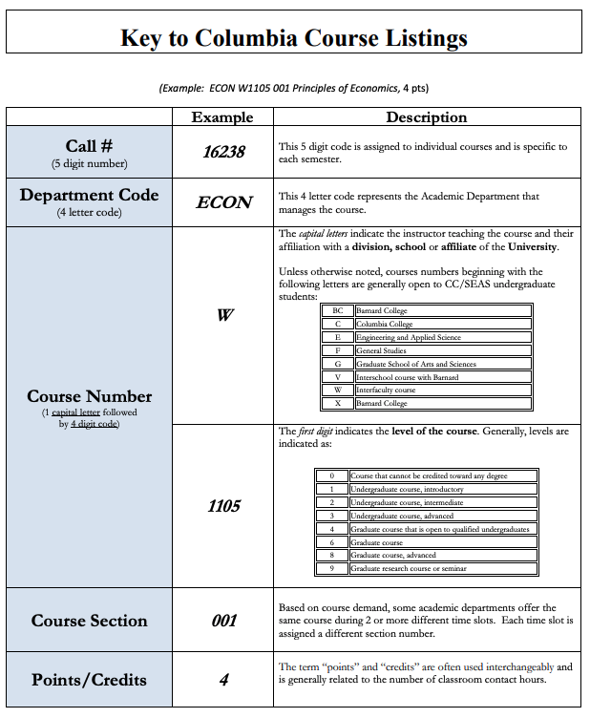
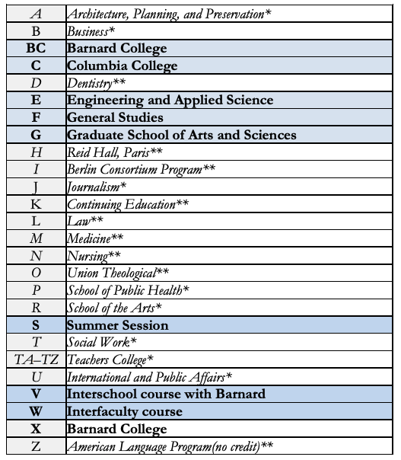
Course Number
https://www.cc-seas.columbia.edu/sites/dsa/files/handbooks/Columbia%20Key%20to%20Course%20Listing.pdf

Slide 74
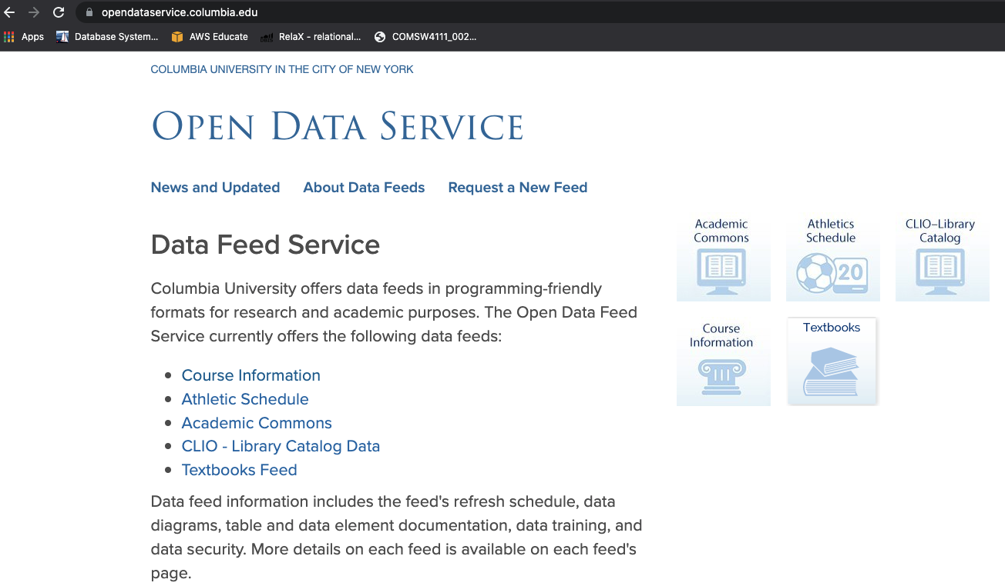
Columbia Open Data Service

Slide 75
Pandas
75 | COMS W4111_002_2023_1: Lecture 3: ER, Relational, SQL (II) © Donald F. Ferguson, 2023

Slide 76
Pandas
“pandas is a software library written for the Python programming language for data manipulation and analysis. In particular, it offers data structures and operations for manipulating numerical tables and time series.
... ...
DataFrame object for data manipulation with integrated indexing.
Tools for reading and writing data between in-memory data structures and different file formats.
Data alignment and integrated handling of missing data.
Reshaping and pivoting of data sets.
Label-based slicing, fancy indexing, and subsetting of large data sets.
Data structure column insertion and deletion.
Group by engine allowing split-apply-combine operations on data sets.
Data set merging and joining.
Hierarchical axis indexing to work with high-dimensional data in a lower-dimensional data structure.
Time series-functionality: Date range generation[6] and frequency conversions, moving window statistics, moving window linear regressions, date shifting and lagging.
Provides data filtration.”
https://en.wikipedia.org/wiki/Pandas_(software)

Slide 77
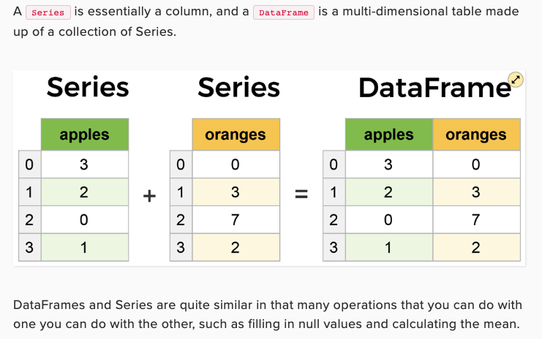
Pandas
Very Excel/Google Sheet like, but with
Integration with Python and libraries.
Some very powerful features.
Also has basic SQL like functions.
The ability to read from and right to many data sources.
We will periodically cover details.

Slide 78
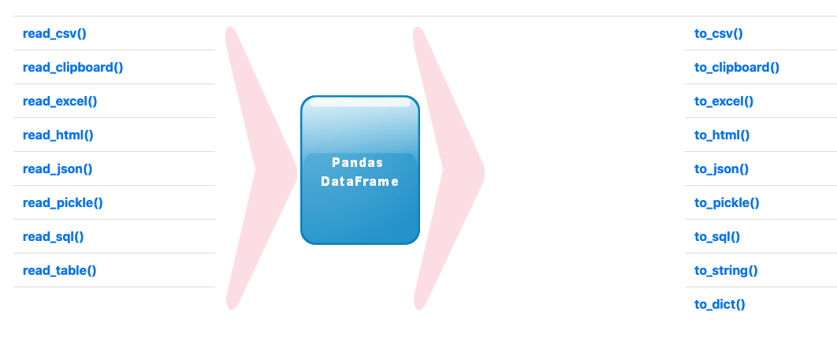
Pandas
https://www.plus2net.com/python/pandas-input-output.php

Slide 79
Switch to Notebook and Show Use
Notebook I used to build Student-Mentor sheet.
Reminding me where the notebook is
http://localhost:8888/notebooks/Dropbox/Columbia/W4111-Intro-to-DB-S22/DONOTSHARE/TA-MENTOR.ipynb

Slide 80
Web Application and Notebook
80 | COMS W4111_002_2023_1: Lecture 3: ER, Relational, SQL (II) © Donald F. Ferguson, 2023

Slide 81
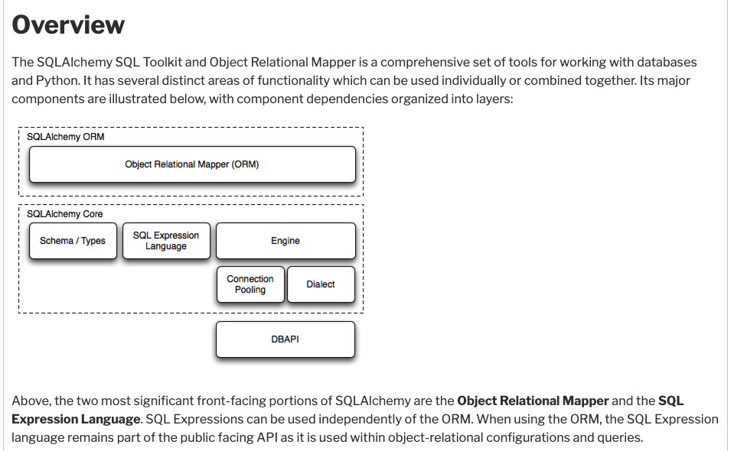
SQL Alchemy is a Common Tool in Python
You have seen me use SQLAlchemy in notebooks.
The %SQL extension uses it.
Switch to notebook

Slide 82
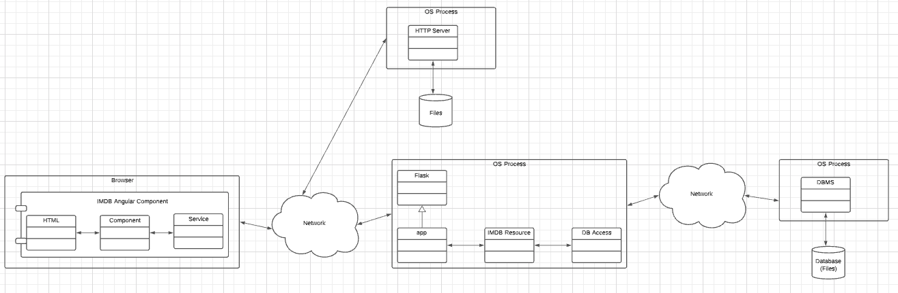
HW 1 – Some Help
Walk through code in IMDB demo and in HW1

Slide 83
Set Operations
83 | COMS W4111_002_2023_1: Lecture 3: ER, Relational, SQL (III) © Donald F. Ferguson, 2023

Slide 84
Set Operations

Slide 85
Set Operations (Cont.)
Set operations union, intersect, and except
Each of the above operations automatically eliminates duplicates
To retain all duplicates use the
union all,
intersect all
except all.
NOTE:
SELECT implementing a project can have duplicate rows. If you do not want duplicates, you must use the DISTINCT key word.
UNION behaves the other way. It removes duplicates. If you want to keep the duplicates, you have to select UNION ALL.
Some SQL engines do not implement INTERSECT and/or EXCEPT, you can implement the function with subqueries, which we will cover soon.

Slide 86
Set Operations
Find courses that ran in Fall 2017 or in Spring 2018
(select course_id from section where sem = 'Fall' and year = 2017) union (select course_id from section where sem = 'Spring' and year = 2018)
Find courses that ran in Fall 2017 and in Spring 2018
(select course_id from section where sem = 'Fall' and year = 2017) intersect (select course_id from section where sem = 'Spring' and year = 2018)
Find courses that ran in Fall 2017 but not in Spring 2018
(select course_id from section where sem = 'Fall' and year = 2017) except (select course_id from section where sem = 'Spring' and year = 2018)

Slide 87
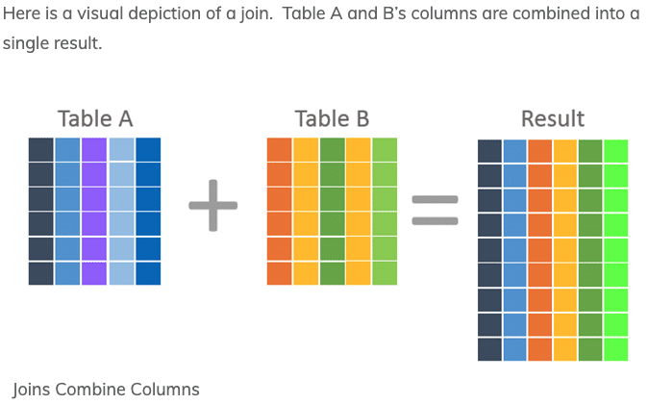
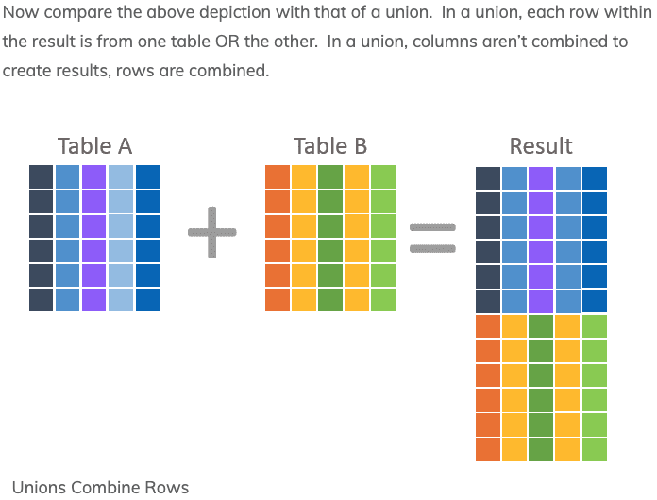
JOIN and UNION – A Final Word
UNION vs JOIN can be confusing. Basically,
JOIN puts the tables together “side by side.”
Union puts the tables together “one on top of the oter.”

Slide 88
Sub-Query
88 | COMS W4111_002_2023_1: Lecture 3: ER, Relational, SQL (III) © Donald F. Ferguson, 2023

Slide 89
Nested Subqueries
SQL provides a mechanism for the nesting of subqueries. A subquery is a select-from-where expression that is nested within another query.
The nesting can be done in the following SQL query select A₁, A₂, ..., A_{n} from r₁, r₂, ..., r_{m} where P
as follows:
From clause: r_{i} can be replaced by any valid subquery
Where clause: P can be replaced with an expression of the form:
B <operation> (subquery)
B is an attribute and <operation> to be defined later.
Select clause:
A_{i} can be replaced be a subquery that generates a single value.
Note:
This is a little cryptic.
I think I know what they mean.
There are some operations we will see later in the material, e.g IN, EXISTS, ... ...

Slide 90
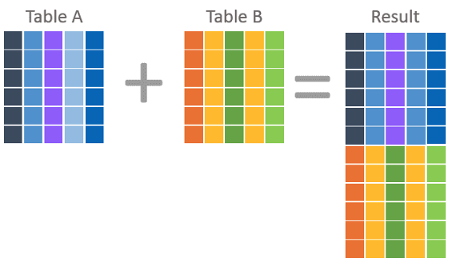
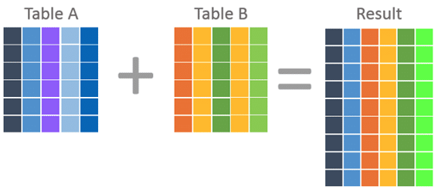
Nested Subquery
The slides that come with the book have surprisingly little material on nested subqueries.
The concept is:
Extremely important.
Students often find subqueries more confusing than joins.
The relationship/difference of subqueries to joins is often, initial unclear.
We have seen:
Union sort of puts a table on top of a table.
Join puts tables sort of puts tables side-by-side.
Subquery enables one query to call another during execution like a subfunction.

Slide 91
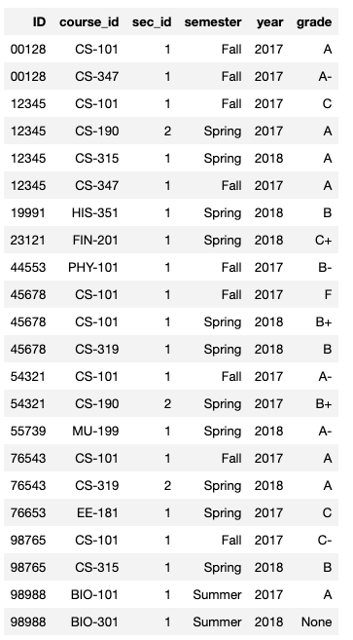
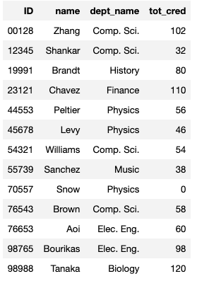
Consider Some Tables
Student
Takes

Slide 92
Consider a Subquery Tables
select *, (select name from student where student.id=takes.id) as name from takes;
Assume I wrote a function find_student_name(x)
Input is an x
Loops through all students and returns students with student.ID = x.
The query with a subquery above is like:
result = []
For t in takes:
new_r = t + find_student_name(t.id)
result.append(new_r)
Switch to Notebook
Takes
Student

Slide 93
Nested Subqueries
SQL provides a mechanism for the nesting of subqueries. A subquery is a select-from-where expression that is nested within another query.
The nesting can be done in the following SQL query select A₁, A₂, ..., A_{n} from r₁, r₂, ..., r_{m} where P
as follows:
From clause: r_{i} can be replaced by any valid subquery
Where clause: P can be replaced with an expression of the form:
B <operation> (subquery)
B is an attribute and <operation> to be defined later.
Select clause:
A_{i} can be replaced be a subquery that generates a single value.
Note: Subquery MUST return
A single scalar if in the SELECT.
A Table if in the FROM.
If in the WHERE:
Either a scalar or a table.
Depending on the operation.

Slide 94
Set Membership

Slide 95
Set Membership
Find courses offered in Fall 2017 and in Spring 2018
Find courses offered in Fall 2017 but not in Spring 2018
select distinct course_id
from section
where semester = 'Fall' and year= 2017 and course_id in (select course_id
from section
where semester = 'Spring' and year= 2018);
select distinct course_id
from section
where semester = 'Fall' and year= 2017 and course_id not in (select course_id
from section
where semester = 'Spring' and year= 2018);

Slide 96
Set Membership (Cont.)
Name all instructors whose name is neither “Mozart” nor Einstein”
select distinct name
from instructor
where name not in ('Mozart', 'Einstein')
Find the total number of (distinct) students who have taken course sections taught by the instructor with ID 10101
Note: Above query can be written in a much simpler manner. The formulation above is simply to illustrate SQL features
select count (distinct ID)
from takes
where (course_id, sec_id, semester, year) in (select course_id, sec_id, semester, year
from teaches
where teaches.ID= 10101);

Slide 97
Set Comparison

Slide 98
Set Comparison – “some” Clause
Find names of instructors with salary greater than that of some (at least one) instructor in the Biology department.
Same query using > some clause
select distinct T.name
from instructor as T, instructor as S
where T.salary > S.salary and S.dept name = 'Biology';
select name
from instructor
where salary > some (select salary
from instructor
where dept name = 'Biology');

Slide 99
Definition of “some” Clause
F <comp> some r ⇔ ∃ t ∈ r such that (F <comp> t ) Where <comp> can be: <, ≤, >, =, ≠
0
(5 < some
5
) = true
(read: 5 < some tuple in the relation)
6
0
(5 < some
5
) = false
0
(5 = some
) = true
5
0
(5 ≠ some
5
) = true (since 0 ≠ 5)
(= some) ≡ in
However, (≠ some) ≡ not in

Slide 100
Set Comparison – “all” Clause
Find the names of all instructors whose salary is greater than the salary of all instructors in the Biology department.
select name
from instructor
where salary > all (select salary
from instructor
where dept name = 'Biology');

Slide 101
Definition of “all” Clause
F <comp> all r ⇔ ∀ t ∈ r (F <comp> t)
0
(5 < all
5
) = false
6
6
(5 < all
) = true
10
4
(5 = all
) = false
5
4
(5 ≠ all
) = true (since 5 ≠ 4 and 5 ≠ 6)
6
(≠ all) ≡ not in
However, (= all) ≡ in

Slide 102
Test for Empty Relations
The exists construct returns the value true if the argument subquery is nonempty.
exists r ⇔ r ≠ Ø
not exists r ⇔ r = Ø

Slide 103
Use of “exists” Clause
Yet another way of specifying the query “Find all courses taught in both the Fall 2017 semester and in the Spring 2018 semester”
select course_id from section as S where semester = 'Fall' and year = 2017 and exists (select * from section as T where semester = 'Spring' and year= 2018 and S.course_id = T.course_id);
Correlation name – variable S in the outer query
Correlated subquery – the inner query

Slide 104
Use of “not exists” Clause
Find all students who have taken all courses offered in the Biology department.
Note that X – Y = Ø ⇔ X ⊆ Y
Note: Cannot write this query using = all and its variants
select distinct S.ID, S.name
from student as S
where not exists ( (select course_id
from course
where dept_name = 'Biology')
except
(select T.course_id
from takes as T
where S.ID = T.ID));
First nested query lists all courses offered in Biology
Second nested query lists all courses a particular student took

Slide 105
Test for Absence of Duplicate Tuples
The unique construct tests whether a subquery has any duplicate tuples in its result.
The unique construct evaluates to “true” if a given subquery contains no duplicates .
Find all courses that were offered at most once in 2017
select T.course_id from course as T where unique ( select R.course_id from section as R where T.course_id= R.course_id and R.year = 2017);

Slide 106
Subqueries in the From Clause

Slide 107
Subqueries in the Form Clause
SQL allows a subquery expression to be used in the from clause
Find the average instructors’ salaries of those departments where the average salary is greater than $42,000.”
select dept_name, avg_salary from ( select dept_name, avg (salary) as avg_salary from instructor group by dept_name) where avg_salary > 42000;
Note that we do not need to use the having clause
Another way to write above query
select dept_name, avg_salary from ( select dept_name, avg (salary) from instructor group by dept_name)
as dept_avg (dept_name, avg_salary)
where avg_salary > 42000;

Slide 108
With Clause
The with clause provides a way of defining a temporary relation whose definition is available only to the query in which the with clause occurs.
Find all departments with the maximum budget with max_budget (value) as (select max(budget) from department) select department.name from department, max_budget where department.budget = max_budget.value;

Slide 109
Complex Queries using With Clause
Find all departments where the total salary is greater than the average of the total salary at all departments
with dept _total (dept_name, value) as
(select dept_name, sum(salary)
from instructor
group by dept_name),
dept_total_avg(value) as
(select avg(value)
from dept_total)
select dept_name
from dept_total, dept_total_avg
where dept_total.value > dept_total_avg.value;

Slide 110
Scalar Subquery
Scalar subquery is one which is used where a single value is expected
List all departments along with the number of instructors in each department
select dept_name, ( select count(*) from instructor where department.dept_name = instructor.dept_name) as num_instructors from department;
Runtime error if subquery returns more than one result tuple

